Slide 1

Hurricane Harvey effects housing market on Houston,Tx

Slide 2

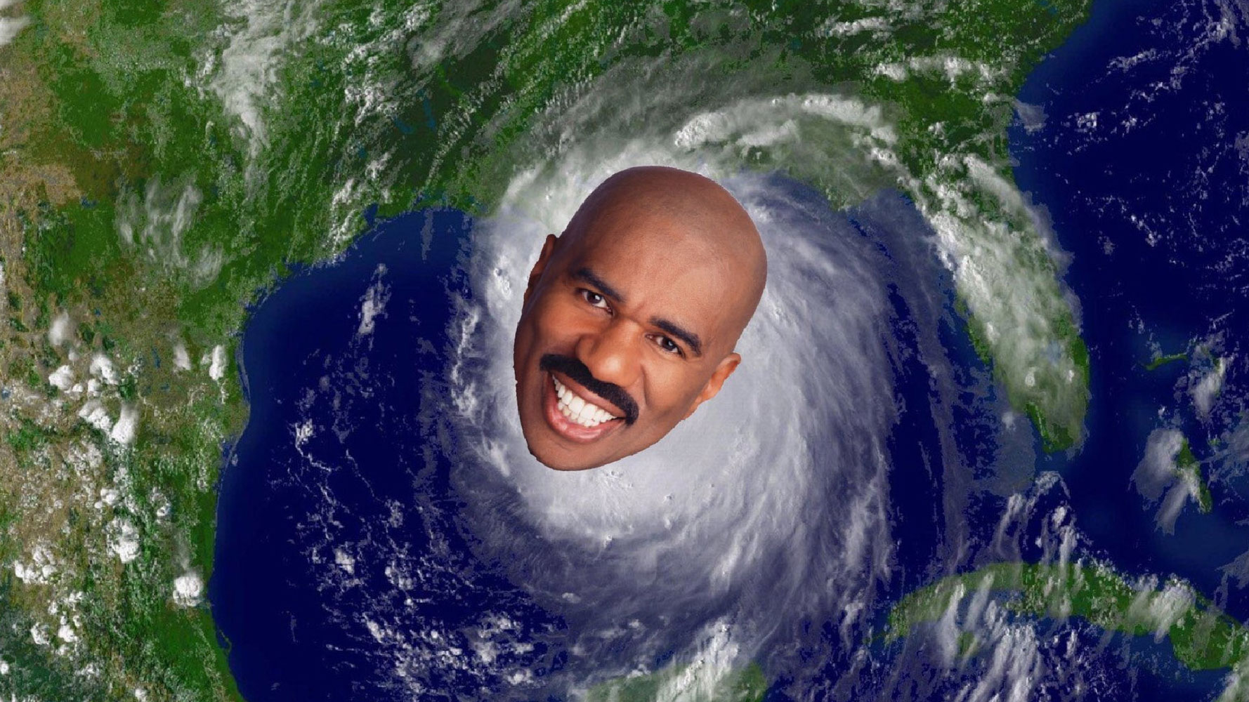
What Happened Hurricane Harvey ON Houston,Tx ?
Notes:
Notes:

Slide 3
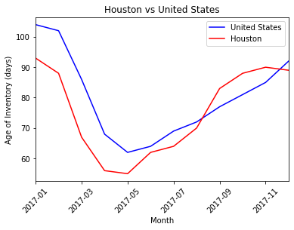
Age of inventory
Notes:
Age of inventory
United States Trend vs. Houston Trend Pre-Harvey-Date of Event- Post-Harvey

Slide 4
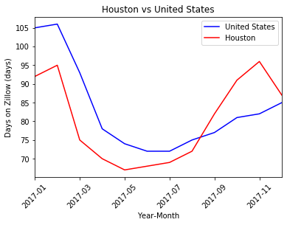

Days on Zillow
Notes:
Age of inventory
United States Trend vs. Houston Trend Pre-Harvey-Date of Event- Post-Harvey

Slide 5
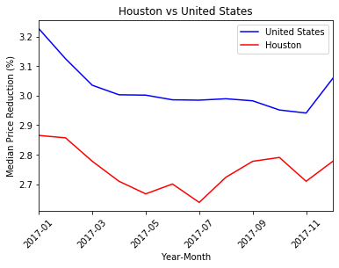
Median Price reduction
Notes:
Age of inventory
United States Trend vs. Houston Trend Pre-Harvey-Date of Event- Post-Harvey

Slide 6
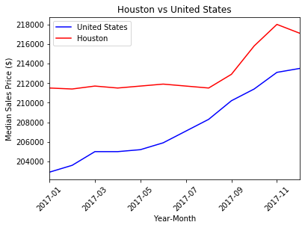
Median SALES PRICE
Notes:
Age of inventory
United States Trend vs. Houston Trend Pre-Harvey-Date of Event- Post-Harvey

Slide 7
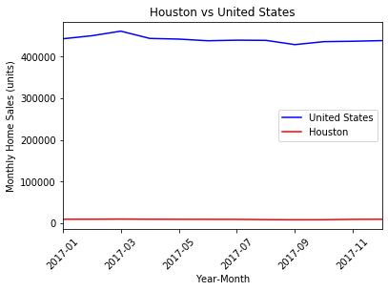

MONTHLY HOME SALES

